Slide 1
Introduction to DevOps

Slide 2
Agenda
Limitations of Waterfall and Agile
What / Why DevOps
DevOps Benefits
Continuous in DevOps
DevOps Lifecycle Flow
Case Study

Slide 3
Limitations of Waterfall Model

Slide 4
Agile Methodology

Slide 5
Limitations of Agile

Slide 6
Disadvantages of Agile
Poor resource planning
Limited documentation
Fragmented output
No finite end
Difficult measurement

Slide 7


DevOps is NOT
Separate Silos
Dev
Ops

Slide 8


DevOps is
Smooth Collaboration
Dev
Ops

Slide 9
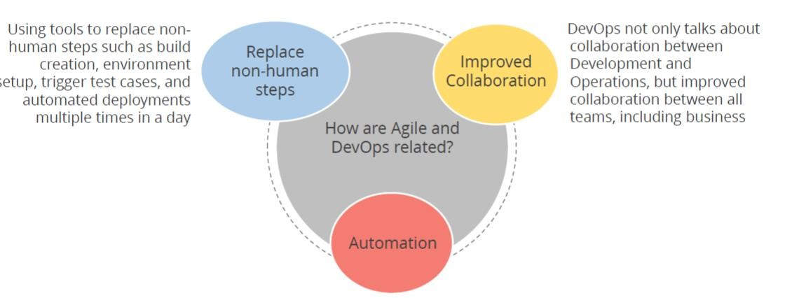
AGILE & DEVOPS

Slide 10

What is DevOps
DevOps is the combination of cultural philosophies, practices, and tools.
Increases an organization’s ability to deliver applications and services at high velocity evolving and improving products at a faster pace.
Enables organizations to better serve their customers and compete more effectively in the market.

Slide 11
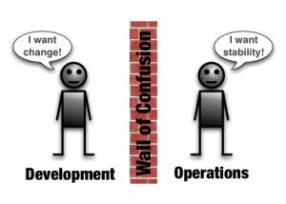
Benefits of DevOps
Efficiency - Faster time to market
Predictability - Lower failure rate of new releases
Reproducibility – Version everything
Maintainability - Faster time to recovery in the event of a new release crashing or otherwise disabling the current system
Break down the wall between development and operations

Slide 12
Developer Challenges

Slide 13
Operations Challenges

Slide 14
Business Benefits of DevOps

Slide 15
DevOps Adoption

Slide 16
Cultural Adoption
DevOps culture is all about a shared understanding between developers and operations, and sharing responsibility for the software they build.
Increases transparency, communication, and collaboration across development, IT/operations, and "the business".

Slide 17
Process Transformation
DevOps transformation is a process wherein enterprises reshape their organisational strategy and bring positive cultural change by implementing DevOps practices and breaking traditional silos.
DevOps processes with continuous integration, continuous testing, and continuous delivery results in improving business processes and ensures faster software delivery.

Slide 18
Technology Transformation
Enterprises needs to be keep up with the latest technology on a regular basis
They require updated hardware and software to avoid performance issues

Slide 19
Automate Everything
DevOps automation is the practice of automating repetitive and manual DevOps tasks to be carried out without any human interaction.
Automation can be applied throughout the DevOps lifecycle, spanning:
Design and development
Software deployment and release
Monitoring

Slide 20
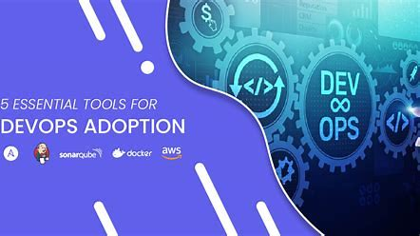
Adoption of Tools
It is necessary to integrate all the tools properly to make testing , deployment and building all work together in a continuous manner

Slide 21
DevOps Engineer Skills

Slide 22
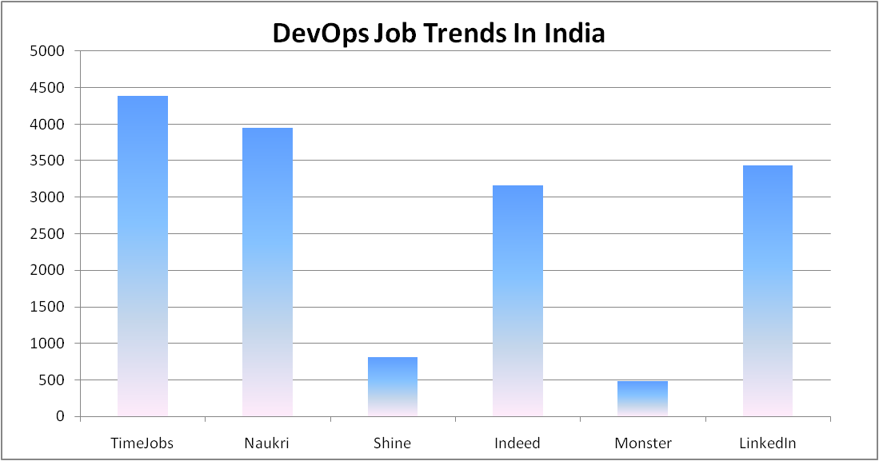

Slide 23
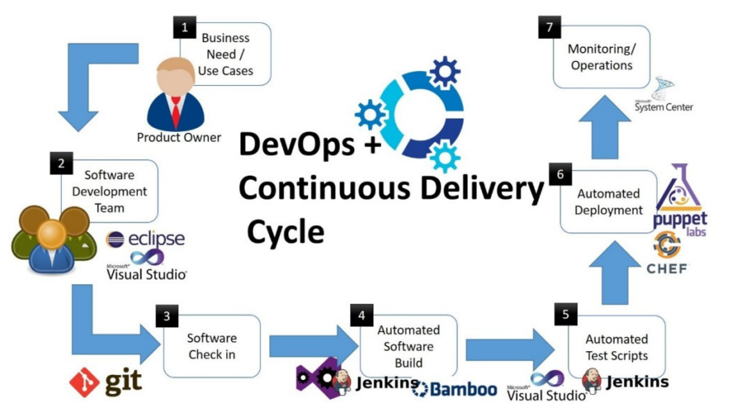
DevOps Cycle Flow

Slide 24
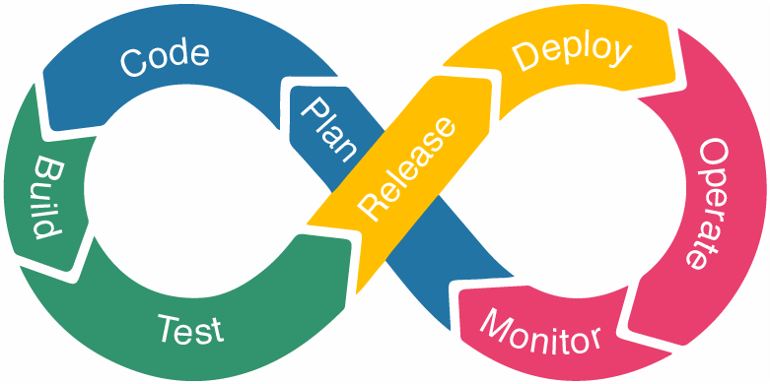
DevOps Lifecycle

Slide 25
DevOps Lifecycle
1. Code: In this step, the developers write the code on any platform to develop the product for a customer.
2. Build: Process of creating software from sources, which includes gathering dependencies, compiling, archiving, transforming code in any way, but also testing, deploying to different environments, and promoting the artifacts between them.
3. Test: Built products are tested using the testing tools such as JUnit, Blazemter, Selenium, etc.
4. Release: Involves planning, scheduling, and controlling the built process in a different environment.

Slide 26
DevOps Lifecycle
5. Deploy: Products and files are executed on the server.
6. Operate: The customer is using the product or application for various purposes.
7. Monitor: Delivered products or application to a user is monitored to note down any uptime and downtime failures, errors.
8. Plan: After monitoring, it gathers all the information and feedback from the customer and plans the changes that need to be done to make it better.

Slide 27
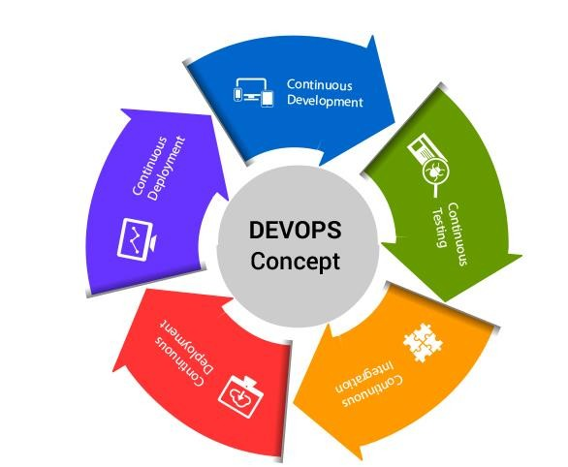
DevOps is all about Continuous
Continuous Development: Software is developed continuously
Continuous Testing : Software is continuously tested for bugs
Continuous Integration: Code supporting new functionality is integrated with the existing code
Continuous Deployment: Code is deployed to the production environment
Continuous Monitoring: Dedicated monitoring tools which will continuously monitor the application performance and highlight issues.

Slide 28
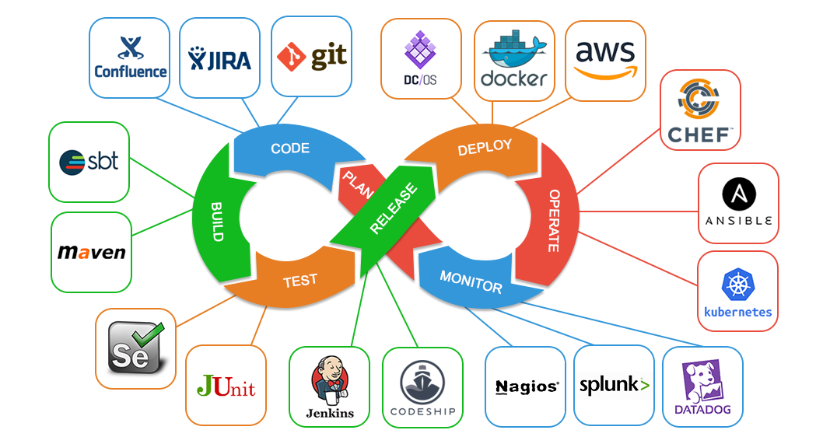
DevOps Tools

Slide 29
CASE STUDY
In 2011, Facebook rolled out a slew of new features – timeline, ticker and music functionalities – to its 500 million users spread across the globe.The huge traffic that was generated on Facebook following the release led to a server meltdown.The features that were rolled out garnered mixed response from users which led to inconclusive results of the effectiveness of the new features, leaving them with no actionable insights.

Slide 30



CASE STUDY .. Contd
Once the features were stable,
they were deployed on other
03
user bases in multiple releases.
They were continuously monitored and the feedback was continuously developed & tested
02
The new features were deployed on a smaller and specific user base.
01

Slide 31
CASE STUDY .. Contd
Facebook used Dark launching technique which is the process of gradually rolling out production-ready features to a select set of users before a full release.
Allowed development teams to get user feedback early on, test bugs, and also stress test infrastructure performance.
A direct result of continuous delivery, this method of release helped in faster, more iterative releases that ensured that application performance does not get affected and that the release is well received by customers.

Slide 32
Thank You

